Slide 1

Satan's
Rev. 13–14
Dr. Rick Griffith, Crossroads International Church Singapore
cicfamily.com & BibleStudyDownloads.org
Used with permission
Notes:
Preached at CIC on 16 March 2014

Slide 2
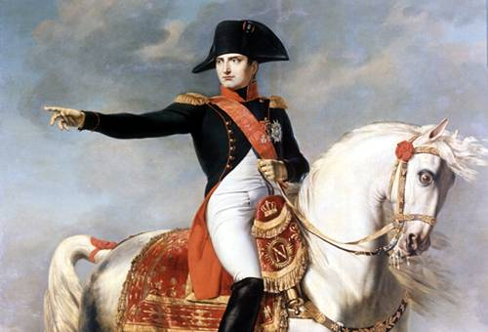
Napoleon

Slide 3
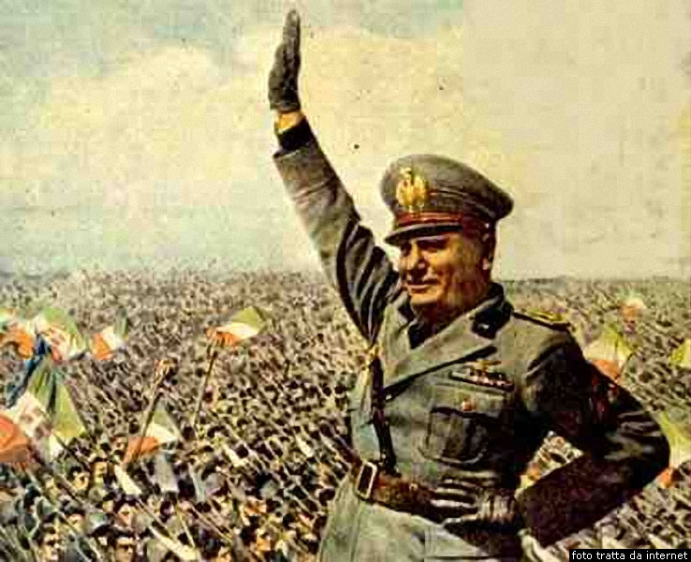
Mussolini

Slide 4
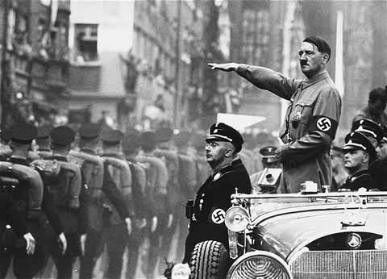
Hitler

Slide 5
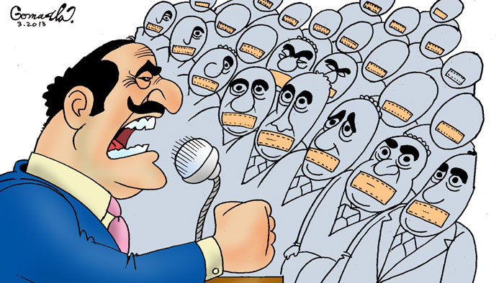
Do you think the world is leading to more democracies or more dictators?

Slide 6
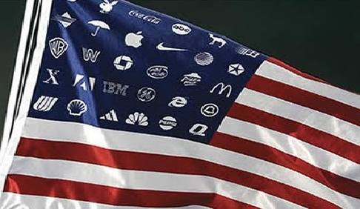
Text

Slide 7
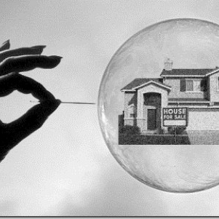
US Housing Bubble

Slide 8
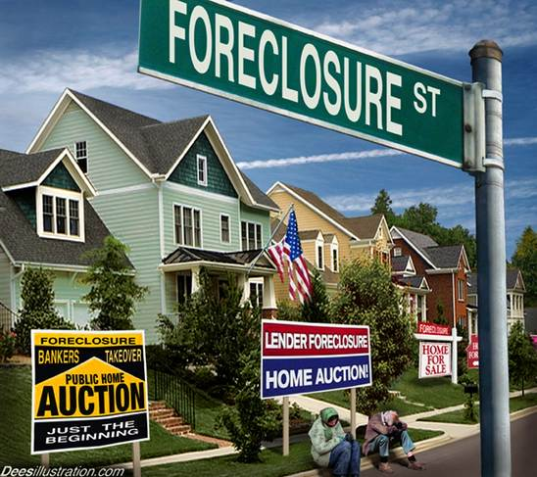
US Housing Bubble

Slide 9
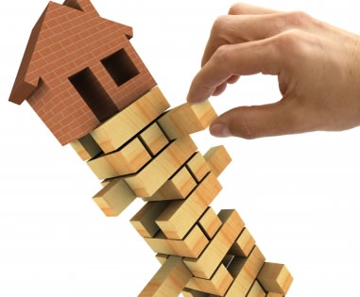
Housing Collapse

Slide 10
USA Private Debt in Green (1952-2009)
Notes:
https://customers.reuters.com/d/graphics/USDEBT2.pdf accessed 15 March 2014

Slide 11
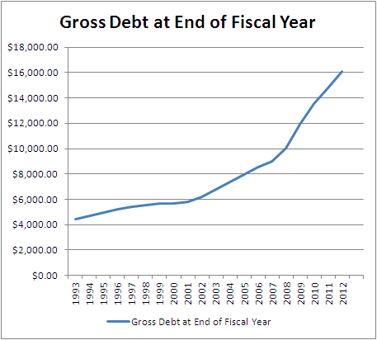
US Gross National Debt
2013
$17T
2008
$10T
2013
Notes:
25 Oct 2013 article by Rick Manning at http://netrightdaily.com/2013/10/time-debt-vigilance/ accessed 15 March 2014

Slide 12
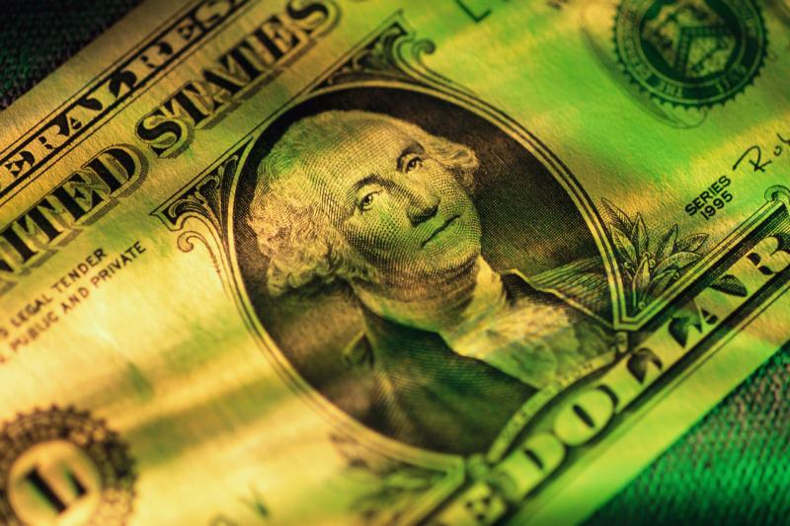
Every American citizen's share of this debt is $55,108.98.

Slide 13
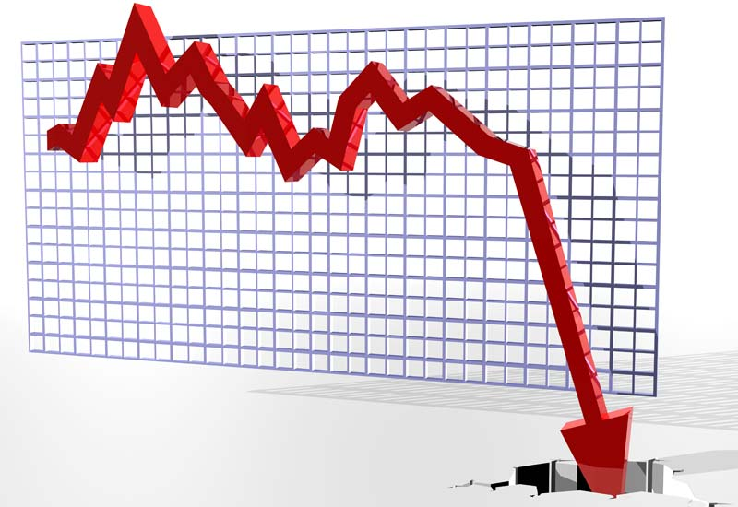
Text

Slide 14
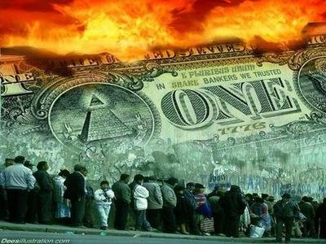
Is America a Democracy?

Slide 15
"The word 'democracy' comes from two Greek words: demos meaning 'the people' and kratia meaning 'to rule,' therefore democracy means 'the people rule.' Majority rule may sound like a good idea, but, essentially, it translates to mean 'mob rule.'"
Dr. Hartnell (history teacher)
http://www.nuttyhistory.com/american-gov.html

Slide 16
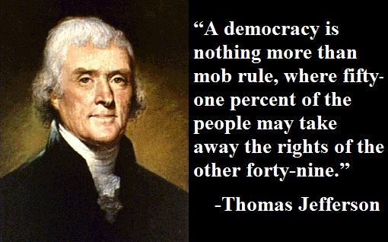
"A democracy is nothing more than mob rule, where fifty-one percent of the people may take away the rights of the other forty-nine."
—Thomas Jefferson

Slide 17
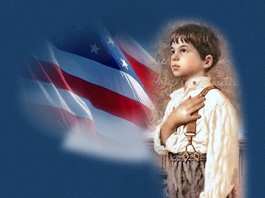
"I pledge allegiance to the flag of the United States of America, and to the republic for which it stands, one nation, under God…"
Notes:
What is the American form of government?
July 23, 2010 by Stephen Palmer
"The most common–and grossly incorrect–answer to this question is that we are a democracy. The right–albeit simplistic–answer is that we are a republic. A more sophisticated answer is that we are a constitutional republic." http://www.thesocialleader.com/2010/07/american-form-government/

Slide 18
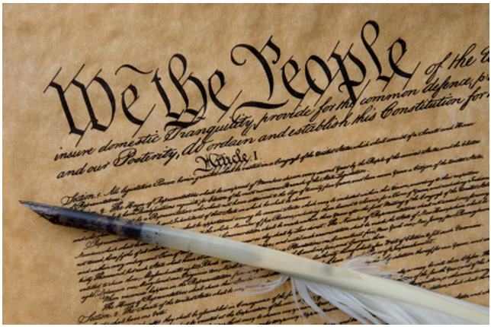
Constitution = Republic
Notes:
Republic - a representative democracy in which the people's elected deputies (representatives), not the people themselves, vote on legislation.
http://www.indexmundi.com/singapore/government_type.html

Slide 19
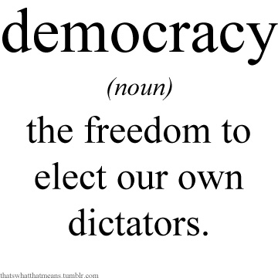
Democracy Defined
democracy
(noun)
the freedom to elect our own dictators.

Slide 20
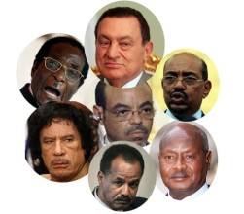
Dictators
The rise of democracies is a key step toward one world government!

Slide 21

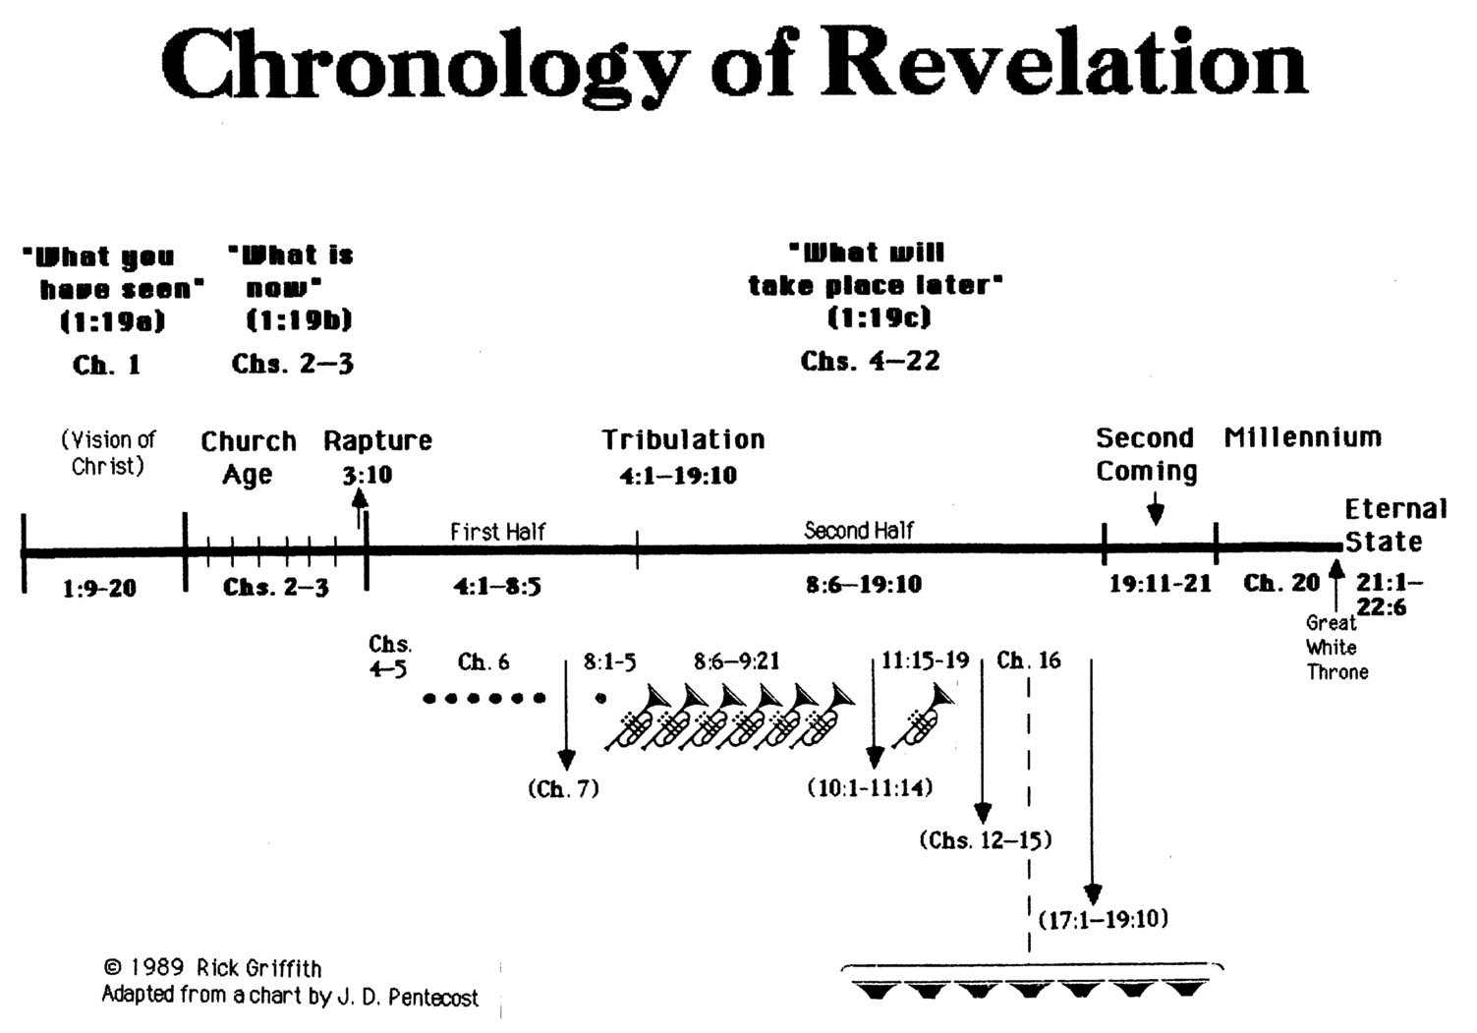
Chronology of Revelation
340
"What you have seen"
(1:19a)
Rev. 1
"What is
now"
(1:19b)
Rev. 2–3
"What will
take place later"
(1:19c)
Rev. 4–22
Vision of Christ
Church
Age
Rapture
3:10
Tribulation
4:1 – 19:10
Second Coming
Millennium
First Half
Second Half
Eternal State
Great White Throne Judgment
Copyright 1989 Rick Griffith
Adapted from a chart by J. D. Pentecost
Notes:
The 3 main divisions of Revelation are summarized in 1:19
The 3 main cycles of judgment are squared in blue
The 4 parenthetical sections appear in parentheses within the scrolls. They do not advance the chronology but add important information that is not associated with a particular judgment.

Slide 22
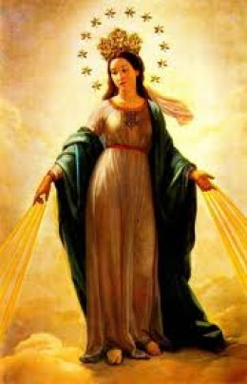
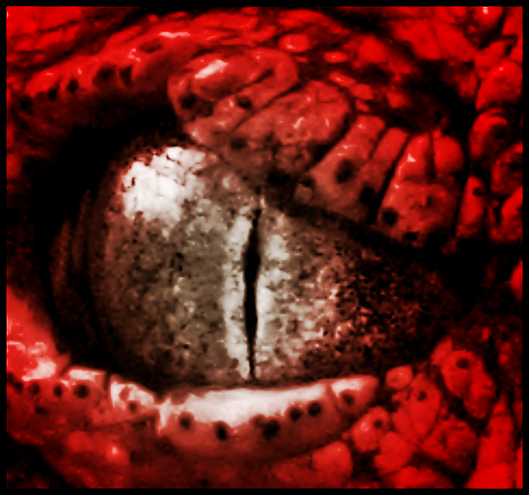
Revelation 12
Satan
Israel

Slide 23
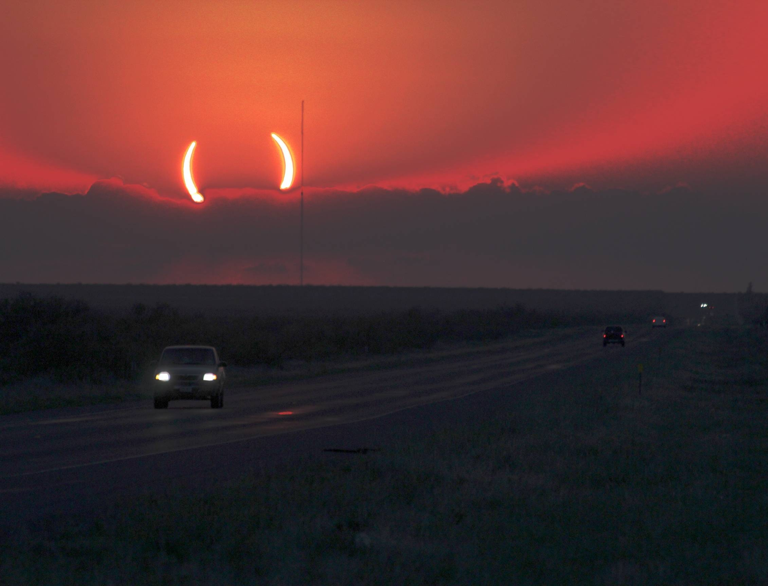
The Great Parenthesis
(
)
10–11 Witnesses
12
Satan
13–14
Henchmen

Slide 24
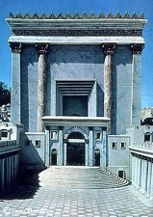

When Did John Write Revelation?
NTS 39-41, 320
Who was the Roman Emperor then?
Christ Crucified
AD 33
Jerusalem Destroyed
AD 70
Revelation Written
AD 95
Tiberius
14-37
Caligula
37-41
Claudius
41-54
Nero
54-68
Vespasian
69-79
Titus
79-81
Domitian
81-96
Supported by:
Irenaeus
Victorinus of Pettau Clement of Alexandria
Eusebius
Notes:
Emperors in black persecuted Christians
I believe that Revelation was written during the reign of Domitian at the end of the first century.

Slide 25
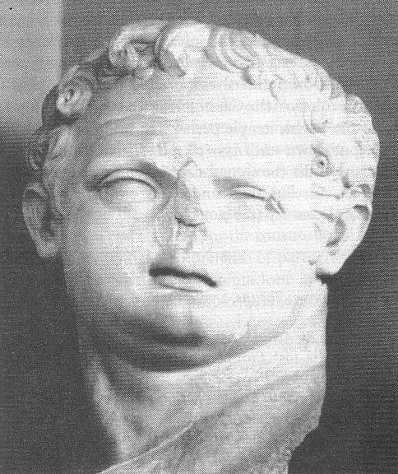
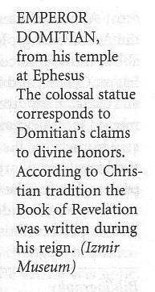
Domitian (AD 81-96)
This bust of Domitian was found in his huge temple at Ephesus—consistent with his claim to divine honors
Book of Revelation (AD 95)

Slide 26
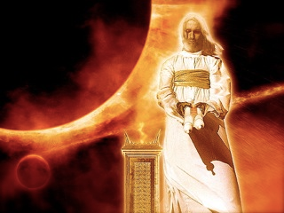

How should we live now when we know Satan will rule the whole world during the Tribulation?
Satan
Christ
Rev. 13
Rev. 14

Slide 27
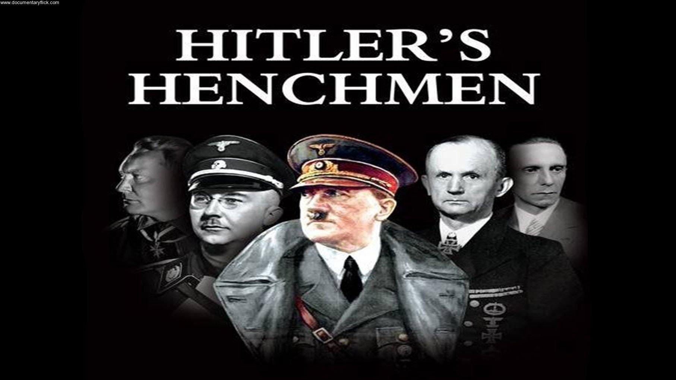
Hitler's Henchmen

Slide 28
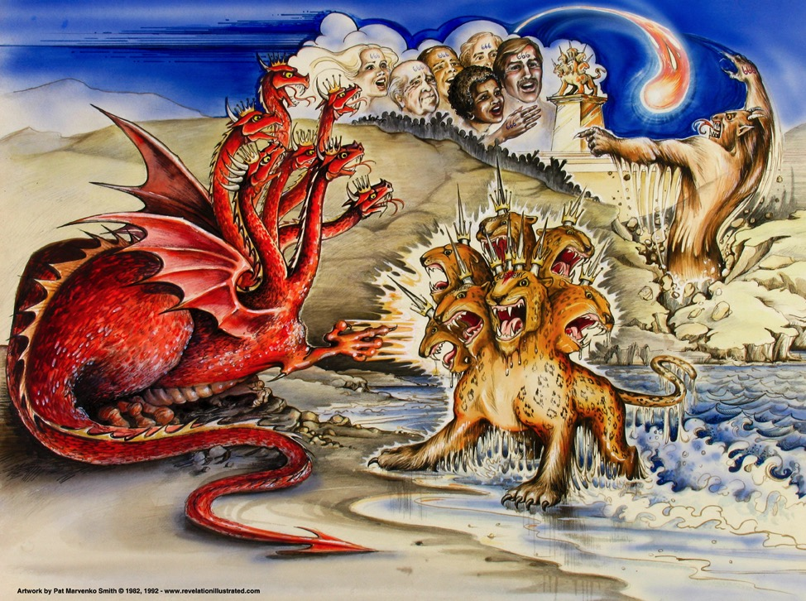
I. Satan will rule the world through his two key henchmen (Rev. 13).
387
Dragon =
Satan
Land Beast =
False Prophet
Sea Beast =
Antichrist
Used with permission

Slide 29
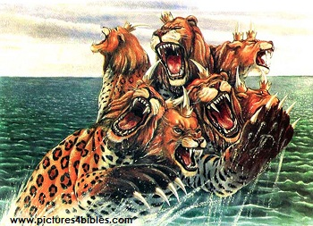
The Beast
387
"Then I saw a beast rising up out of the sea.
It had seven heads and ten horns, with ten crowns on its horns. And written on each head were names that blasphemed God"
(13:1 NLT).
Notes:
"The three animals named in Revelation 13:2 remind us of the four beasts Daniel saw in his dream (Dan. 7): a lion (Babylon), a bear (Media-Persia), a leopard (Greece), and a "terrible beast" (the Antichrist). John saw these animals, or kingdoms, in reverse order since he was looking back, while Daniel was looking ahead. The final world empire will be rooted in all the previous empires and unite in one their evil and power. Added to the ferocity of these beasts will be Satan's own power, throne, and authority!" (Wiersbe).

Slide 30
The Beast
387
Why "beast"?
"The symbolic description of 'the beast' enables us to learn something about his origin and character. God does not see him as a man, made in the divine image, but as a wild animal, under the control of Satan. He is a man (Rev. 13:18); but he is energized from hell, for he comes out of the pit (Rev. 11:7; 17:8). Just as Jesus Christ is God in the flesh, so 'the beast' will be Satan in a human body (see John 13:2, 27)" (Wiersbe).
Notes:
"The three animals named in Revelation 13:2 remind us of the four beasts Daniel saw in his dream (Dan. 7): a lion (Babylon), a bear (Media-Persia), a leopard (Greece), and a "terrible beast" (the Antichrist). John saw these animals, or kingdoms, in reverse order since he was looking back, while Daniel was looking ahead. The final world empire will be rooted in all the previous empires and unite in one their evil and power. Added to the ferocity of these beasts will be Satan's own power, throne, and authority!" (Wiersbe).

Slide 31
The Beast
387
Why rising from the sea?
"The fact that the beast comes out from the sea indicates that he is a Gentile, for the sea of humanity is involved as his source
(cf. Rev. 17:15)" (Walvoord, BKC).
Notes:
"The three animals named in Revelation 13:2 remind us of the four beasts Daniel saw in his dream (Dan. 7): a lion (Babylon), a bear (Media-Persia), a leopard (Greece), and a "terrible beast" (the Antichrist). John saw these animals, or kingdoms, in reverse order since he was looking back, while Daniel was looking ahead. The final world empire will be rooted in all the previous empires and unite in one their evil and power. Added to the ferocity of these beasts will be Satan's own power, throne, and authority!" (Wiersbe).

Slide 32
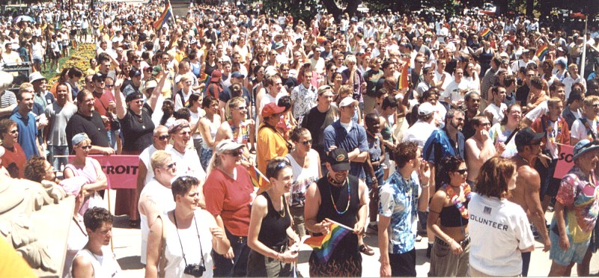
The Beast
387
What does
"the sea" symbolize?
"The waters where the prostitute is ruling represent masses of people of every nation and language" (Rev. 17:15 NLT).
Notes:
"The three animals named in Revelation 13:2 remind us of the four beasts Daniel saw in his dream (Dan. 7): a lion (Babylon), a bear (Media-Persia), a leopard (Greece), and a "terrible beast" (the Antichrist). John saw these animals, or kingdoms, in reverse order since he was looking back, while Daniel was looking ahead. The final world empire will be rooted in all the previous empires and unite in one their evil and power. Added to the ferocity of these beasts will be Satan's own power, throne, and authority!" (Wiersbe).

Slide 33
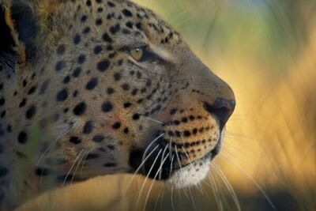
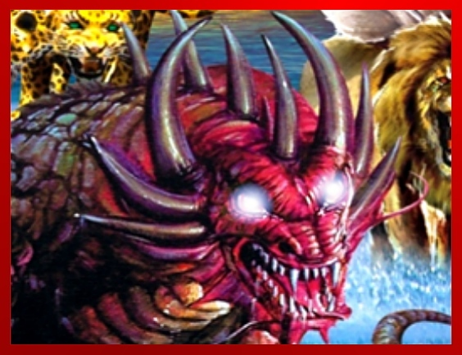
The Beast
387
"This beast looked like a leopard, but it had the feet of a bear and the mouth of a lion! And the dragon gave the beast his own power and throne and great authority" (13:2 NLT).
Notes:
"The three animals named in Revelation 13:2 remind us of the four beasts Daniel saw in his dream (Dan. 7): a lion (Babylon), a bear (Media-Persia), a leopard (Greece), and a "terrible beast" (the Antichrist). John saw these animals, or kingdoms, in reverse order since he was looking back, while Daniel was looking ahead. The final world empire will be rooted in all the previous empires and unite in one their evil and power. Added to the ferocity of these beasts will be Satan's own power, throne, and authority!" (Wiersbe).

Slide 34
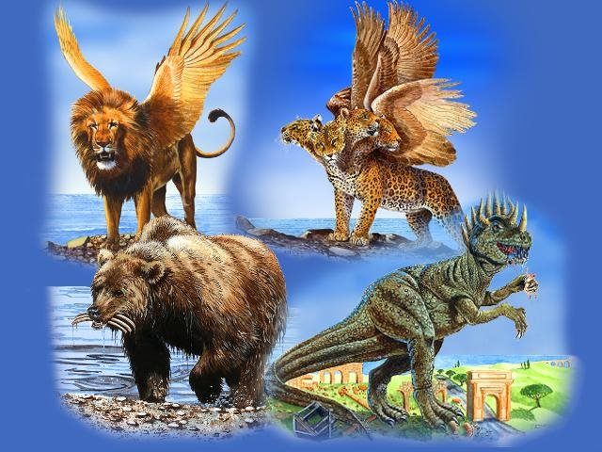
Revelation 13 Alludes to Nations in Daniel 7
331
Babylon
Greece
Rome
Medo-Persia
Notes:
Slides 3-8 appear in the Revelation 1-12 slide show as slides 104-109 so just copy the translated slides from there.

Slide 35
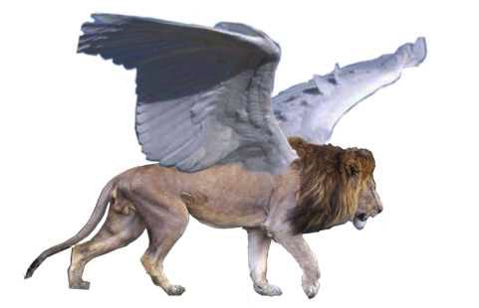
Beast 1: Winged Lion (Babylon)
331

Slide 36
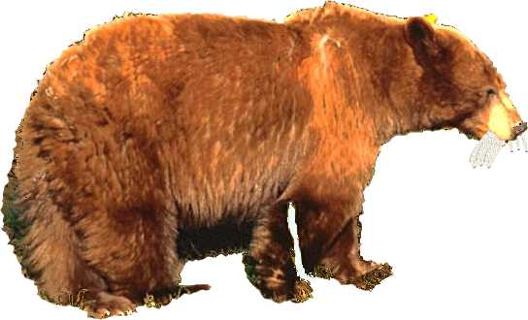
Beast 2: Bear (Medo-Persia)
331

Slide 37
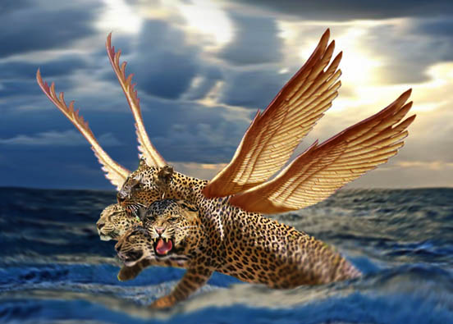
Beast 3: Leopard (Greece)
331

Slide 38
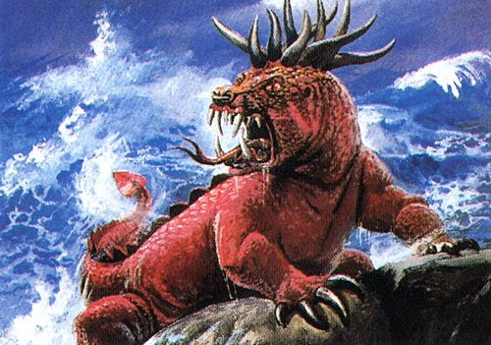
Beast 4: Terrifying (Rome)
331
Daniel 7:7

Slide 39
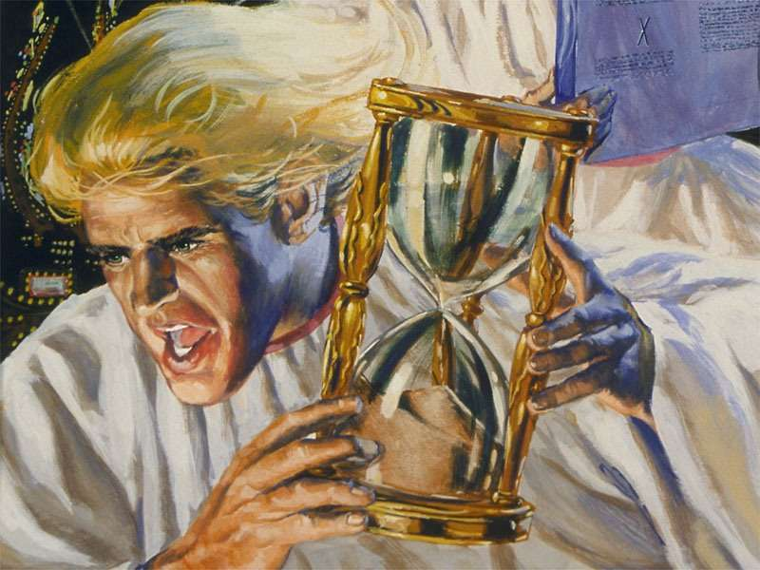
Little Horn on Beast 4 (Antichrist)
331
Daniel 7:8

Slide 40
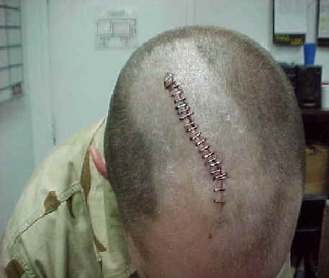
"I saw that one of the heads of the beast seemed wounded beyond recovery—but the fatal wound was healed! The whole world marveled at this miracle and gave allegiance to the beast. ⁴They worshiped the dragon for giving the beast such power, and they also worshiped the beast. 'Who is as great as the beast?' they exclaimed. 'Who is able to fight against him?'" (13:3-4).
388
Notes:
Satan worship is becoming much more popular in the USA, even though Satan does not care if people worship him or something or someone else—as long as this is not God! Every major city in the USA has a Satanic church. One former Satanic priest, Mike Warnke, is now a Christian. He estimates that 80% of missing persons who have never been found were offered as human sacrifices.
"Not only will there be wonder, but there will also be worship (Rev. 13:4). Worship is the one thing Satan has always wanted (Matt. 4:8–10), and he will receive it through "the beast." The second "beast," described in the last half of this chapter, will organize and promote the worship of Antichrist, making it the official religion of the world!" (Wiersbe).

Slide 41
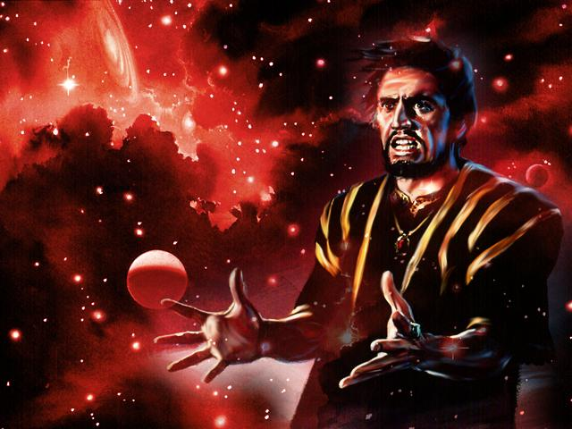
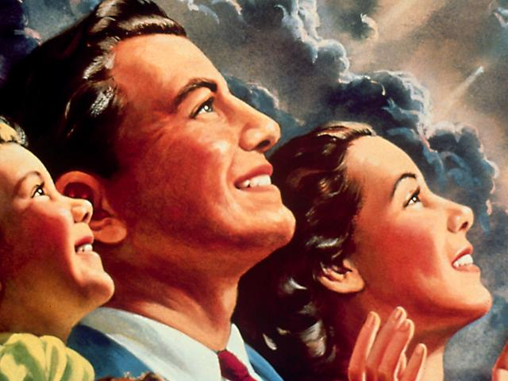
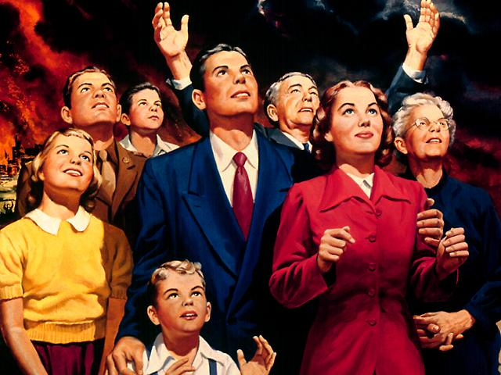
The world will worship the beast
388

Slide 42
Beast Blasphemies (13:5-7 NLT)
"Then the beast was allowed to speak great blasphemies against God. And he was given authority to do whatever he wanted for forty-two months. ⁶And he spoke terrible words of blasphemy against God, slandering his name and his dwelling—that is, those who dwell in heaven. ⁷And the beast was allowed to wage war against God's holy people and to conquer them. And he was given authority to rule over every tribe and people and language and nation."
388

Slide 43
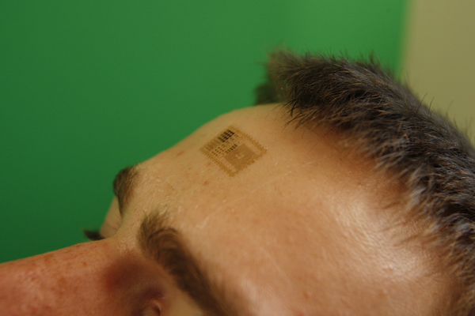
"And all the people who belong to this world worshiped the beast. They are the ones whose names were not written in the Book of Life before the world was made—the Book that belongs to the Lamb who was slaughtered" (13:8 NLT).
388

Slide 44
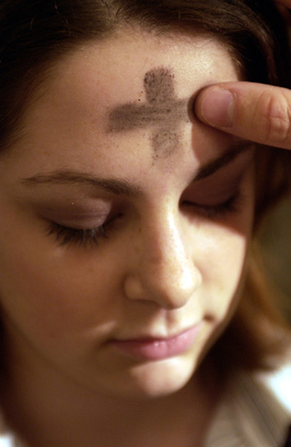
"Anyone with ears to hear should listen and understand.
¹⁰Anyone who is destined for prison will be taken to prison.
Anyone destined to die by the sword will die by the sword.
This means that God's holy people must endure persecution patiently and remain faithful"
(13:9-10 NLT).
388

Slide 45
The Land Beast will glorify Antichrist
387
Dragon =
Satan
Land Beast =
False Prophet
Sea Beast =
Antichrist
Used with permission

Slide 46
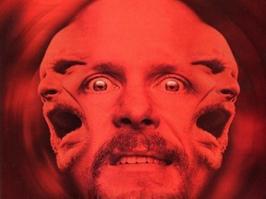
A Satanic "Trinity":
387
"Father" =
Satan
"Son" =
Antichrist
"Spirit" =
False Prophet

Slide 47
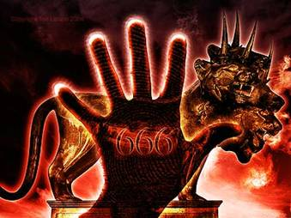
The Mark in the Right Hand
"He causes all, both small and great, rich and poor, free and slave, to receive a mark on their right hand or on their foreheads, and that no one may buy or sell except one who has the mark or the name of the beast, or the number of his name."
388
Revelation 13:16-17

Slide 48
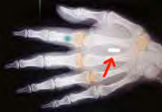
The Mark in the Right Hand
"He causes all, both small and great, rich and poor, free and slave, to receive a mark on their right hand or on their foreheads, and that no one may buy or sell except one who has the mark or the name of the beast, or the number of his name."
388
Revelation 13:16-17

Slide 49
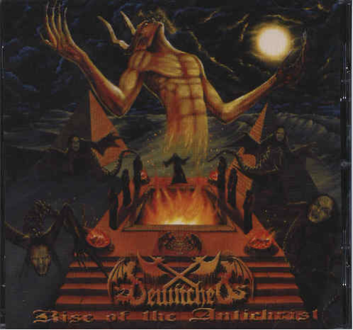
Who is the Antichrist?
388

Slide 50
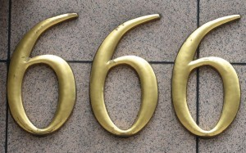
The following slides show how some spiritualize "beast"…
388
The Counterfeit
& False

Slide 51
The Dragon!
388
Satan:
The arch-enemy of God; the one who hates all truth, all goodness, all of God's creatures; the one who would make himself God, if he could!

Slide 52

The Beast Spiritualized
388
The Beast:
The World's political systems. They demand and achieve worship and obedience from all but those who belong to the Lamb. The effect is to take the world into Satan's power.

Slide 53
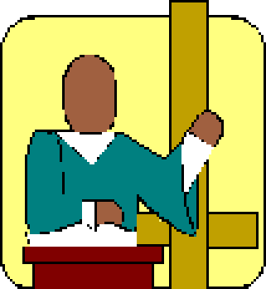
The False Prophet Spiritualized
388
The False Prophet:
Every Ideology, Religion and/or Technology which leads mankind astray by highly plausible (but false) principles, miracles or works. His goal is to cause humanity to worship the Beast.

Slide 54
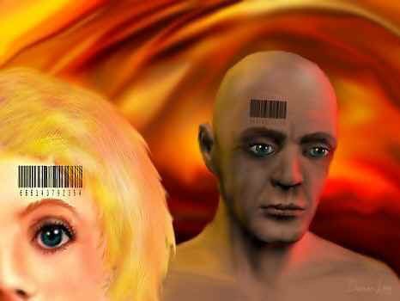
But he is referred to as a person and the number of his name is 666
(Revelation 13:18)
388

Slide 55

Why is the beast is a person?
Number is "man's number" (13:18)
Called "he" (13:6)
Dies and rises again (13:3)
Worshipped (13:4, 8)
"Man of sin" (2 Thess. 2:2)
Thrown into lake of fire (19:20)
Notes:
Why can't the US Congress be the beast? Just lay a leopard skin over it!

Slide 56

Gematria in Greek
388
Hebrew, Greek and Latin used letters as numbers
http://religion-cults.com/antichrist/666.htm
Notes:
religion-cults.com/ antichrist/666.htm

Slide 57

Nero = 666?
388
http://religion-cults.com/antichrist/666.htm

Slide 58

Hebrew Gematria
388
English | Greek | Hebrew | Value
A | Alpha | Aleph | 1
B | Beta | Beth | 2
C | Gamma | Gimmel | 3
D | Delta | Daleth | 4
E | Epsilon | He | 5
F |  | Waw | 6
G |  | Zahyin | 7
H | Eta | Heth | 8
www = 666
http://religion-cults.com/antichrist/666.htm

Slide 59
English Gematria
388
K | 66
I | 54
S | 114
S | 114
I | 54
N | 84
G | 42
E | 30
R | 108
 | 666
A | 6
B | 12
C | 18
D | 24
E | 30
F | 36
G | 42
H | 48
I | 54
J | 60
K | 66
L | 72
M | 78
N | 84
O | 90
P | 96
Q | 102
R | 108
S | 114
T | 120
U | 126
V | 132
W | 138
X | 144
Kissinger = Antichrist!

Slide 60

THE UPC BAR CODE
388
BUT WOULD THE JEWS IN THE NEXT VERSE (REV. 14:1) ALSO HAVE AN INVISIBLE CODE?
http://religion-cults.com/antichrist/mark.htm
Notes:
http://religion-cults.com/antichrist/mark.htm and www.soldierofthelord.4t.com/ photo.html

Slide 61





Mark of the Beast Microchip
388
www.soldierofthelord.4t.com/ photo.html

Slide 62



Monster Drink!
388

Slide 63

Hebrew Alphabet Values
388
Monster Energy Drink =
666

Slide 64

The Sky's the Limit
388
Computations using different systems make each of these total 666: Kissinger, van den broek, lustiger, hitler, deutschland, himmler, new york, us of america, santa claus, kennedy, al gore... Holy Bible, SS number, witchcraft, lustful, monetary, live, son of sin, mark of beast, evil, bullet... internet, billgates+3 (the III), computer, terminal, binary, windows98, teletext, calculation

Slide 65

USA Now 6.666T in Debt
$6.666T
$6.666T

Slide 66
I. Satan will rule the world through his two key henchmen (Rev. 13).
387
Dragon =
Satan
Land Beast =
False Prophet
Sea Beast =
Antichrist
Used with permission

Slide 67
Will anyone survive the Tribulation?

Slide 68
II. Christ will defeat Satan through 144,000 Jews and six more angels
(Rev. 14).

Slide 69

The 144,000 Sing (14:1-5)
389
Notes:
READ 14:1-3

Slide 70

The 144,000 Sing (14:1-5)
389
Notes:
READ 14:4-5

Slide 71


Revelation 14:6-7 NAU
389
"And I saw another angel flying in mid-heaven, having an eternal gospel to preach to those who live on the earth, and to every nation and tribe and tongue and people;
⁷and he said with a loud voice, 'Fear God, and give Him glory, because the hour of His judgment has come; worship Him who made the heaven and the earth and sea and springs of waters.'"
Notes:
"During the present age, the angels are not privileged to preach the Gospel. That responsibility has been given to God's people. While the nations will fear 'the beast' and give honor to him, this heavenly messenger will summon them to fear and honor God alone. It is a reminder that God is the Creator and He alone deserves worship. This is not the Gospel message as we know it (1 Cor. 15:1–4); rather, it is a return to the message of Romans 1:18ff, what theologians call "'natural theology' (Wiersbe).

Slide 72

Jesus formed Adam from the dust (John 1:3; Gen. 2:7).

Slide 73

Jesus Created Adam and Eve (John 1:3; Gen. 2:21-23)

Slide 74

Jesus is best qualified to judge and rescue his creation

Slide 75

Evolution Creation 00896
390
EVOLUTION
MILLIONS OF YEARS
DEATH
MAN'S
EXISTENCE
Suffering • Disease • Bloodshed
CREATION
MAN'S
ACTIONS
DEATH
Notes:
75

Slide 76








7 C's Animated—Gen. 1:31 omitted
CREATION
390
CORRUPTION
CATASTROPHE
THE SEVEN C's OF HISTORY
CONFUSION
CHRIST
CONSUMMATION
CROSS
Notes:
Each element is a TIFF image with alpha channels. This whole page totals 1.1 MB rather than 11+ MB that flat JPEGs would produce.

Slide 77


"Then another angel followed him through the sky, shouting, 'Babylon is fallen—that great city is fallen—because she made all the nations of the world drink the wine of her passionate immorality'" (14:8 NLT)
389

Slide 78

"Then a third angel followed them, shouting, 'Anyone who worships the beast and his statue or who accepts his mark on the forehead or on the hand ¹⁰must drink the wine of God's anger. It has been poured full strength into God's cup of wrath. And they will be tormented with fire and burning sulfur in the presence of the holy angels and the Lamb. ¹¹The smoke of their torment will rise forever and ever, and they will have no relief day or night, for they have worshiped the beast and his statue and have accepted the mark of his name"' (14:9-11 NLT)
389

Slide 79

"And I heard a voice from heaven saying, 'Write this down: Blessed are those who die in the Lord from now on. Yes, says the Spirit, they are blessed indeed, for they will rest from their hard work; for their good deeds follow them!'"
(14:13 NLT)
391

Slide 80

The final judgment is previewed in the imagery of 3 angels trampling grapes in a winepress (14:14-20)
391

Slide 81

"Then I saw a white cloud, and seated on the cloud was someone like the Son of Man. He had a gold crown on his head and a sharp sickle in his hand" (14:14 NLT)

Slide 82



"Then another angel came from the Temple and shouted to the one sitting on the cloud, 'Swing the sickle, for the time of harvest has come; the crop on earth is ripe.' ¹⁶So the one sitting on the cloud swung his sickle over the earth, and the whole earth was harvested" (14:15-16 NLT).
391

Slide 83

"After that, another angel came from the Temple in heaven, and he also had a sharp sickle. ¹⁸Then another angel, who had power to destroy with fire, came from the altar. He shouted to the angel with the sharp sickle, 'Swing your sickle now to gather the clusters of grapes from the vines of the earth, for they are ripe for judgment'" (14:17-18 NLT)

Slide 84


Grapes

Slide 85


"So the angel swung his sickle over the earth and loaded the grapes into the great winepress of God's wrath. ²⁰The grapes were trampled in the winepress outside the city, and blood flowed from the winepress in a stream about 180 miles long and as high as a horse's bridle" (14:19-20 NLT)
391
Notes:
"While this distance may be literal and may designate the area of judgment as around the city of Jerusalem, it is of course impossible for the blood to reach a height where it would touch horses' bridles. What this affirms is a tremendous bloodletting in which blood is spattered as high as the bridles of horses. This is a graphic picture of a great slaughter (Isa. 63:1-3). Other Scriptures (e.g., Rev. 16:14; Dan. 11:40-45) make it clear that there will be a world war of tremendous scope underway at the time of the second coming of Christ, and this may be a partial fulfillment of these prophecies" (Walvoord, BKC).

Slide 86

"…blood flowed from the winepress in a stream about 180 miles long and as high as a horse's bridle" (14:20b NLT)
Notes:
"While this distance may be literal and may designate the area of judgment as around the city of Jerusalem, it is of course impossible for the blood to reach a height where it would touch horses' bridles. What this affirms is a tremendous bloodletting in which blood is spattered as high as the bridles of horses. This is a graphic picture of a great slaughter (Isa. 63:1-3). Other Scriptures (e.g., Rev. 16:14; Dan. 11:40-45) make it clear that there will be a world war of tremendous scope underway at the time of the second coming of Christ, and this may be a partial fulfillment of these prophecies" (Walvoord, BKC).

Slide 87

Show your trust in Christ's victory over Satan by being faithful now.
How should we live now when we know Satan will rule the whole world during the Tribulation?
Main Idea:
Notes:
Knowing the Lamb's victory over the puny power of the coming beasts should motivate us to faithful endurance [MI restated].

Slide 88
I. Satan will rule the world through his two key henchmen (Rev. 13).
387
"God's holy people must endure persecution patiently and remain faithful " (13:10)
Dragon =
Satan
Land Beast =
False Prophet
Sea Beast =
Antichrist
Used with permission

Slide 89
II. Christ will defeat Satan through 144,000 Jews and six more angels
(Rev. 14).
"This means that God's holy people must endure persecution patiently, obeying his commands and maintaining their faith in Jesus"
(14:12)

Slide 90

How can you show faithful endurance now?
Bloom where you're planted.
Impact your marketplace.
Invest your money for eternity.
Use your talents for Christ.
Resist total allegiance to the State.

Slide 91

Stop making excuses.

Slide 92

What is radical?

Slide 94

Jesus Wins!
Series on Revelation

Slide 95


NT Preaching link at BibleStudyDownloads.org
Get this presentation and script for free!
Notes:
NT Preaching (np)

